Slide 1

Password Strength Assessment Tool
Student name: Suryansh Chauhan
Guide Name: MR NISHANT
University Roll.no: 2418014
Class Roll.no : 52
Class: I1 Department: B.tech(CSE)
Graphic Era Hill University

Slide 2
INTRODUCTION
AIM :
The Password Strength Assessment Tool's aim is to offer a user-friendly application for checking the strength of password. The tool lets users to find the strength of password and suggest how should the password should be created if its weak.
PROBLEM STATEMENT :
Weak passwords are a primary reason for many cybersecurity breaches. Users often fail to understand what constitutes a strong password or lack the tools to evaluate them effectively. This project will bridge this gap by offering a tool that evaluates password strength and provides actionable recommendations, making the process intuitive and educational.

Slide 3
The Power of Strong Passwords
Securing Digital Assets
Strong passwords are critical for protecting sensitive information like bank accounts, personal data, and confidential files.
Preventing Unauthorized Access
They act as a primary defense against unauthorized access, hindering hackers and malicious actors from exploiting vulnerabilities.

Slide 4
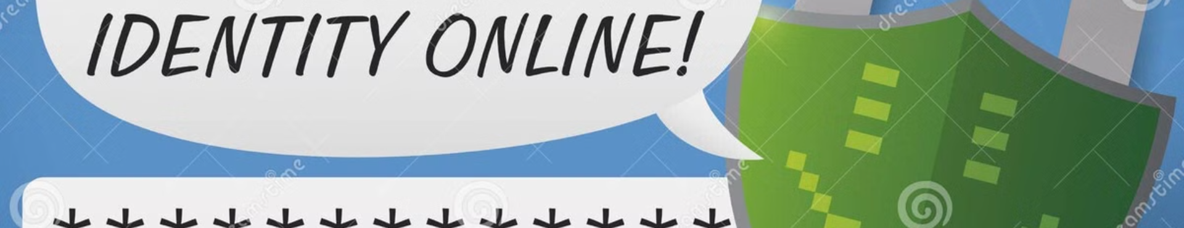
Objectives: Elevating Password Security
1
Evaluation
2
Improvement
3
Enhancement
Assess the strength of user-submitted passwords based on predefined criteria.
Provide clear feedback and recommendations to help users create stronger passwords.
Contribute to a safer digital environment by promoting the use of robust passwords.

Slide 5

Features: Defining Strong Passwords
Complexity
Length
Mix of uppercase, lowercase, numbers, and symbols: Diversity makes it difficult for brute force attacks.
Minimum character count: Longer passwords are harder to guess.
Pattern Avoidance
Dictionary Words
No consecutive characters, keyboard patterns, or common sequences: Prevents easy guessing.
Avoid using dictionary words or names: Common words are easily compromised.

Slide 6
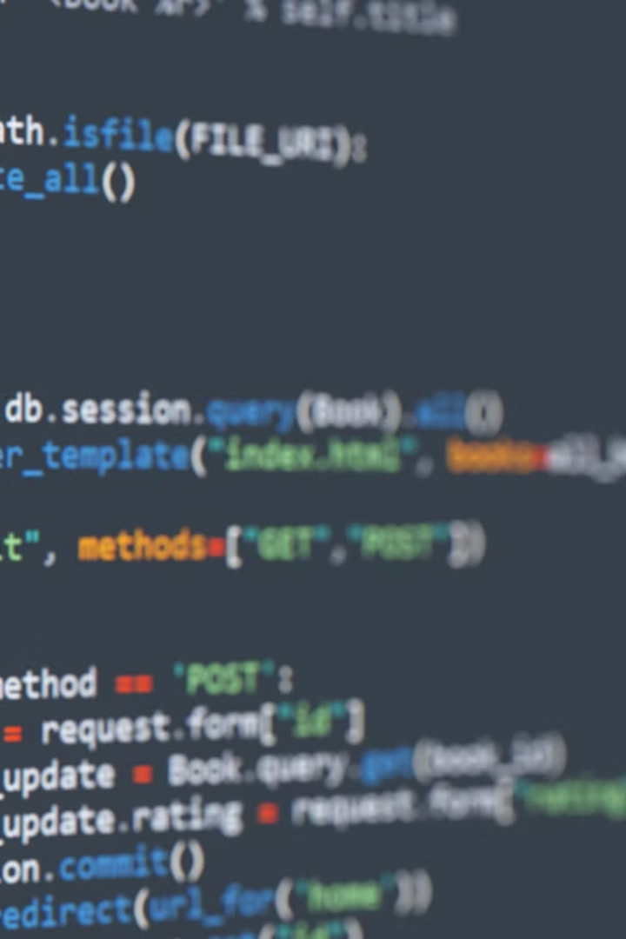


Implementation
Python
HTML, CSS and JAVASCRIPT
Using this programming language for Back End Implementations.
Using these languages for Front End Implementations for GUI.

Slide 7
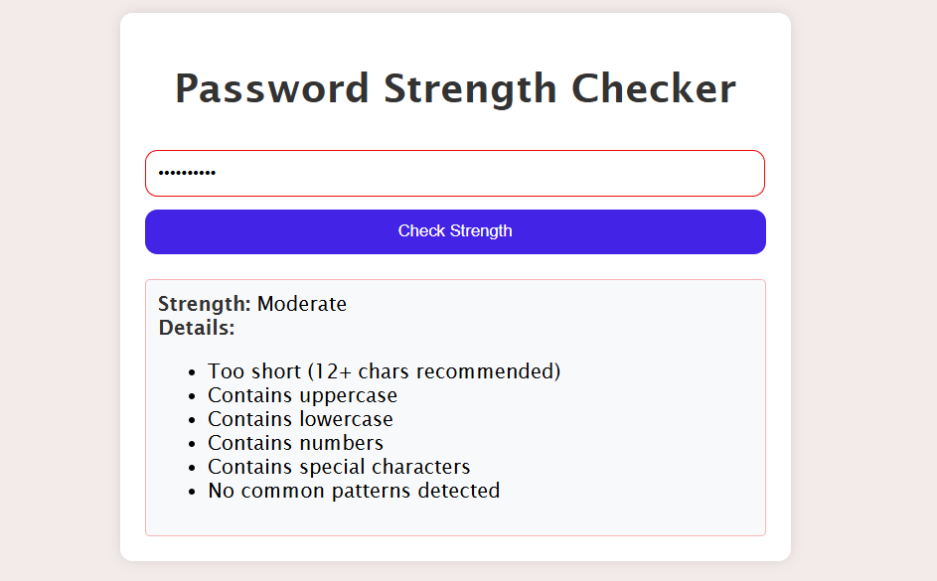
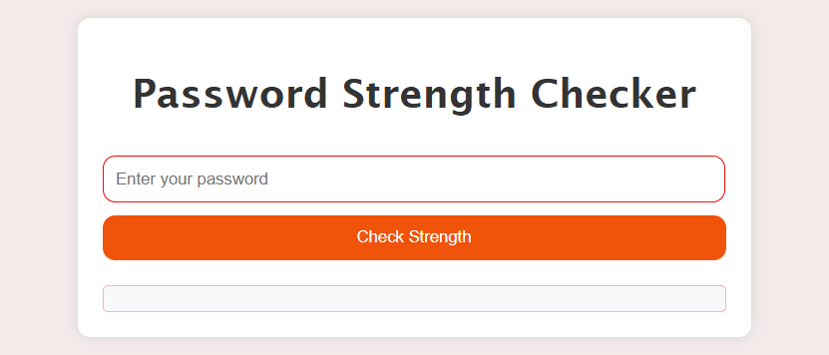
Algorithm: Evaluating Password Strength
1
Input
The user enters a password.
2
Evaluation
The password is analyzed against defined criteria.
3
Score
A strength score (weak, medium, strong) is assigned.
4
Output
The score and relevant feedback are displayed to the user.

Slide 8
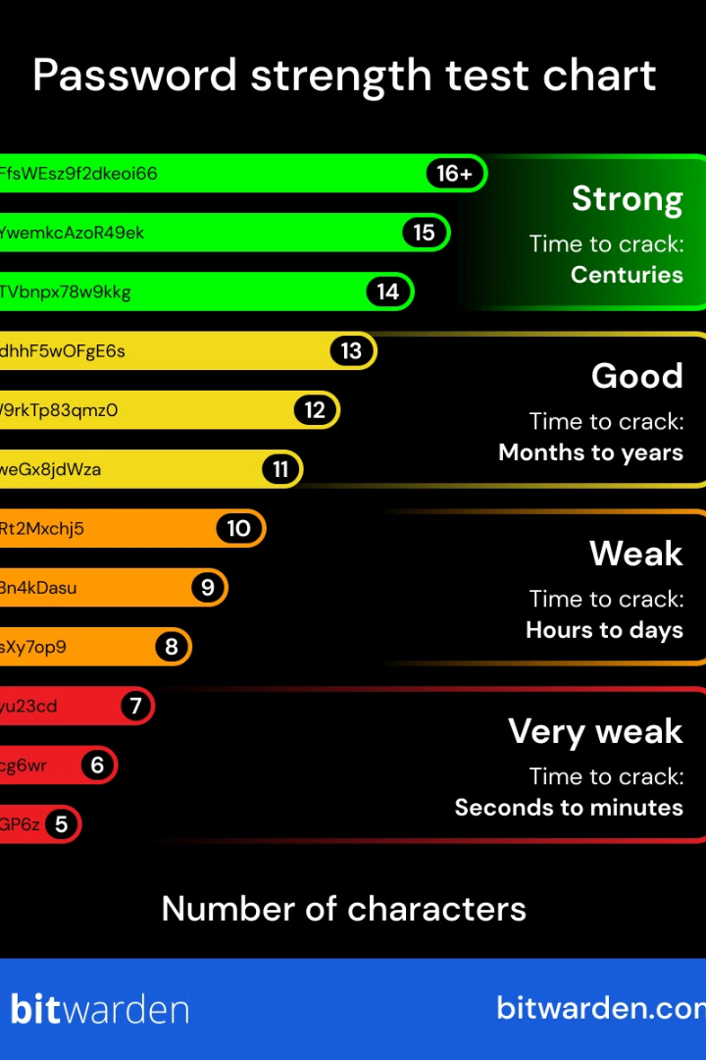
Results: Sample Password Analysis
1
2
Weak
Medium
Password: "P@ssw0rd"
Password: "S3cr3tK3y!"
3
Strong
Password: "MySecret123!@#"

Slide 9

Conclusion:
This Password Strength Assessment Tool empowers users to create stronger passwords, reducing vulnerability to cyberattacks. Promoting password security is a collective responsibility, crucial for a safe and secure digital environment.

Slide 10
THANK YOU

